Slide 1
Great Theorem: Area of a Circle
Archimedes
Journey Through Genius Pp 89

Slide 2
What was known of circles in 225 BC
The ratio of a circle’s circumference to its diameter is always constant (𝜋)
The ratio of a circle’s area to the square of its diameter is always constant (k)

Slide 3
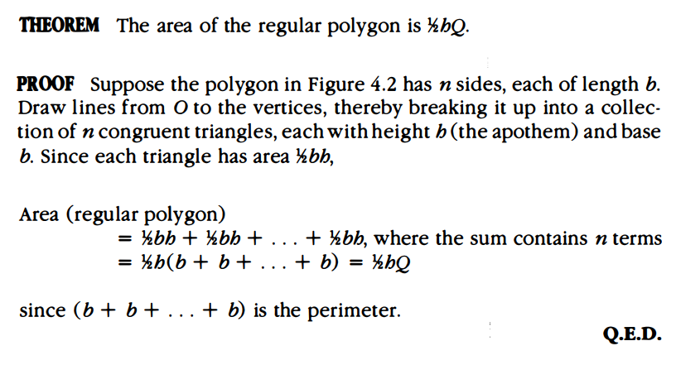
Measurement of a Circle -- Two Preliminaries
The second preliminary involves inscribing regular polygons using Eudoxus’ method of exhaustion.
The idea behind the method of exhaustion is that you can determine a preassigned area such that,
Area (circle) - Area(polygon) = (preassigned) Area
The fact that this specific polygon may require hundreds of sides is irrelevant, what’s important is its existence.
Consider for any circle, we can find polygons inscribed and circumscribed about the circle whose areas are as close to the circle’s area “as we want”, thus establishing upper and lower bounds for the area

Slide 4
Archimedes’ Approach
Showing two things are equal: first he concluded that two quantities A and B can have one of three relationships, A<B, A>B, A=B.
He concluded A>B, then drew a contradiction.
He concluded B>A, then drew a contradiction.
Thus forcing A = B
This is an approach we are familiar with now, but in his time, this had not yet been seen.

Slide 5
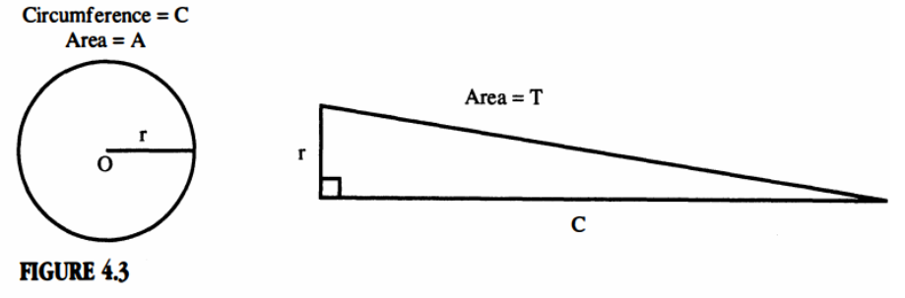
Proposition 1: The area of any circle is equal to a right angled triangle in which one of the sides about the right angle is equal to the radius and the other to the circumference, of the circle.

Slide 6
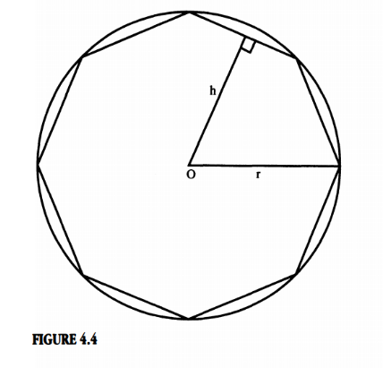
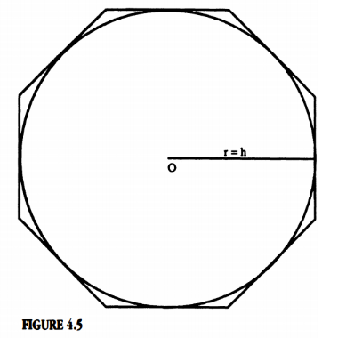
Suppose A>T Suppose A<T

Slide 7
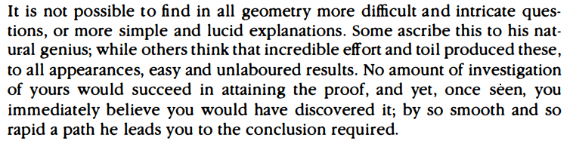
**another passage by Plutarch on Archimedes

Slide 8
Consequences of Archimedes Proof
The proof of Euclid and Hippocrates statement regarding the relationship between the area of circles and the squares of the diameters.
Archimedes also provided a link between the one dimensional circumference and two dimensional area of a circle. Given A = ½ r*C, substitute C for its formula, use this formula to prove Euclid/Hippocrates statement.
The third consequence, it established a relationship between 𝝅 and k, what is this relationship?
The final consequence, Archimedes established upper and lower bounds for 𝝅. Using the method of exhaustion, he again inscribed and circumscribed polygons, but this time focused on the circumference. He drew the conclusion that 3 10/11 <𝝅<3 1/7

